Slide 1
Introduction to Decision Trees

Slide 2
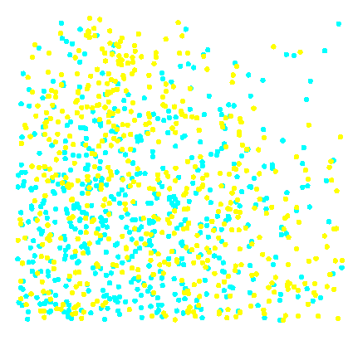
Simple Prediction Illustration
Training Data
1.0
0.9
Predict dot color for each x₁ and x₂.
0.8
0.7
0.6
x₂
0.5
0.4
0.3
0.2
0.1
0.0
0.0
0.1
0.2
0.3
0.4
0.5
0.6
0.7
0.8
0.9
1.0
x₁
...

Slide 3
Simple Prediction Illustration
Training Data
1.0
0.9
Predict dot color for each x₁ and x₂.
0.8
0.7
0.6
x₂
0.5
0.4
0.3
0.2
0.1
0.0
0.0
0.1
0.2
0.3
0.4
0.5
0.6
0.7
0.8
0.9
1.0
x₁
...

Slide 4
Decision Tree Prediction Rules
root node
x₂
1.0
<0.63
≥0.63
0.9
0.8
interior node
0.7
x₁
x₁
0.6
<0.52
≥0.52
<0.51
≥0.51
x₂
0.5
0.4
0.3
70%
0.2
40%
0.1
leaf node
55%
60%
0.0
0.0
0.1
0.2
0.3
0.4
0.5
0.6
0.7
0.8
0.9
1.0
x₁
...
Notes:
Root node: contains all the data
Leaf: where our observations will end up (showing the results)

Slide 5
Decision Tree Prediction Rules
Predict:
root node
x₂
1.0
<0.63
≥0.63
0.9
0.8
interior node
0.7
x₁
x₁
0.6
<0.52
≥0.52
<0.51
≥0.51
x₂
0.5
0.4
0.3
70%
0.2
40%
0.1
leaf node
55%
60%
0.0
0.0
0.1
0.2
0.3
0.4
0.5
0.6
0.7
0.8
0.9
1.0
x₁
...

Slide 6
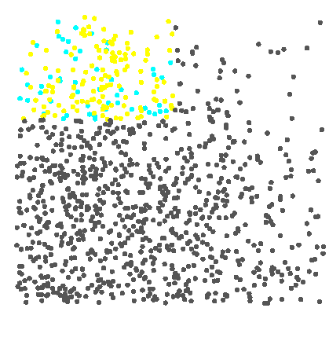
Decision Tree Prediction Rules
Predict:
Decision =
Estimate = 0.70
x₂
1.0
<0.63
0.9
<0.63
≥0.63
0.8
0.7
x₁
0.6
x₁
x₁
<0.52
x₂
<0.52
≥0.52
≥0.52
<0.51
≥0.51
≥0.51
0.5
0.4
0.3
70%
0.2
40%
40%
0.1
55%
55%
60%
0.0
60%
0.0
0.1
0.2
0.3
0.4
0.5
0.6
0.7
0.8
0.9
1.0
x₁
...
Notes:
70% of the dot in the observation area are Yellow, so the prediction result is yellow

Slide 7
Decision Tree Prediction Rules
Predict:
Decision =
Estimate = 0.70
x₂
1.0
<0.63
≥0.63
0.9
0.8
0.7
x₁
x₁
0.6
<0.52
≥0.52
<0.51
≥0.51
x₂
0.5
0.4
0.3
70%
0.2
40%
0.1
55%
60%
0.0
0.0
0.1
0.2
0.3
0.4
0.5
0.6
0.7
0.8
0.9
1.0
x₁
...

Slide 8
Decision Tree Split Search
left
right
1.0
0.9
0.8
0.7
Confusion Matrix
0.6
x₂
0.5
0.4
Calculate the logworth of every partition on input x₁.
0.3
0.2
0.1
0.0
0.0
0.1
0.2
0.3
0.4
0.5
0.6
0.7
0.8
0.9
1.0
x₁
...

Slide 9
Decision Tree Split Search
left
right
0.52
1.0
0.9
0.8
0.7
Confusion Matrix
0.6
x₂
0.5
0.4
Calculate the logworth of every partition on input x₁.
0.3
0.2
0.1
0.0
0.0
0.1
0.2
0.3
0.4
0.5
0.6
0.7
0.8
0.9
1.0
x₁
...

Slide 10
Decision Tree Split Search
left
right
0.52
53%
42%
1.0
max
logworth(x₁)
0.95
0.9
47%
58%
0.8
0.7
0.6
x₂
0.5
0.4
Select the partition with the maximum logworth.
0.3
0.2
0.1
0.0
0.0
0.1
0.2
0.3
0.4
0.5
0.6
0.7
0.8
0.9
1.0
x₁
...

Slide 11
Decision Tree Split Search
left
right
53%
42%
1.0
max
logworth(x₁)
0.95
0.9
47%
58%
0.8
0.7
0.6
x₂
0.5
0.4
0.3
Repeat for input x₂.
0.2
0.1
0.0
0.0
0.1
0.2
0.3
0.4
0.5
0.6
0.7
0.8
0.9
1.0
x₁
...

Slide 12
Decision Tree Split Search
left
right
53%
42%
1.0
max
logworth(x₁)
0.95
0.9
47%
58%
0.8
0.7
0.6
x₂
0.5
bottom
top
0.4
0.3
0.2
0.1
0.0
0.0
0.1
0.2
0.3
0.4
0.5
0.6
0.7
0.8
0.9
1.0
x₁
...

Slide 13
Decision Tree Split Search
left
right
53%
42%
1.0
max
logworth(x₁)
0.95
0.9
47%
58%
0.8
0.7
0.63
0.6
x₂
0.5
bottom
top
0.4
54%
35%
max
logworth(x₂)
4.92
0.3
0.2
46%
65%
0.1
0.0
0.0
0.1
0.2
0.3
0.4
0.5
0.6
0.7
0.8
0.9
1.0
x₁
...

Slide 14
Decision Tree Split Search
left
right
53%
42%
1.0
max
logworth(x₁)
0.95
0.9
47%
58%
0.8
0.7
0.6
Compare partition logworth ratings.
x₂
0.5
bottom
top
0.4
54%
35%
max
logworth(x₂)
4.92
0.3
0.2
46%
65%
0.1
0.0
0.0
0.1
0.2
0.3
0.4
0.5
0.6
0.7
0.8
0.9
1.0
x₁
...
Notes:
Bigger logworth will be better to be considered for the data. So in this case we should slit on X2

Slide 15
Decision Tree Split Search
left
right
53%
42%
1.0
max
logworth(x₁)
0.95
0.9
47%
58%
0.8
0.7
0.63
0.6
x₂
0.5
bottom
top
0.4
54%
35%
max
logworth(x₂)
4.92
0.3
0.2
46%
65%
0.1
0.0
0.0
0.1
0.2
0.3
0.4
0.5
0.6
0.7
0.8
0.9
1.0
x₁
...

Slide 16
Decision Tree Split Search
1.0
x₂
0.9
<0.63
≥0.63
0.8
0.7
0.63
0.6
x₂
0.5
0.4
Create a partition rule from the best partition across all inputs.
0.3
0.2
0.1
0.0
0.0
0.1
0.2
0.3
0.4
0.5
0.6
0.7
0.8
0.9
1.0
x₁
...

Slide 17
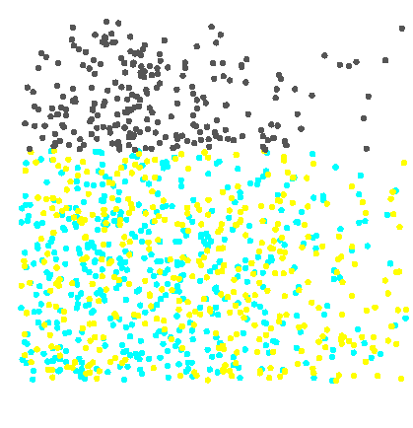
Decision Tree Split Search
1.0
x₂
0.9
<0.63
≥0.63
0.8
0.7
0.6
x₂
0.5
0.4
Repeat the process
in each subset.
0.3
0.2
0.1
0.0
0.0
0.1
0.2
0.3
0.4
0.5
0.6
0.7
0.8
0.9
1.0
x₁
...

Slide 18
Decision Tree Split Search
left
right
1.0
0.9
0.8
0.7
0.6
x₂
0.5
0.4
0.3
0.2
0.1
0.0
0.0
0.1
0.2
0.3
0.4
0.5
0.6
0.7
0.8
0.9
1.0
x₁
...

Slide 19
Decision Tree Split Search
left
right
61%
55%
1.0
max
logworth(x₁)
5.72
0.9
39%
45%
0.8
0.7
0.52
0.6
x₂
0.5
0.4
0.3
0.2
0.1
0.0
0.0
0.1
0.2
0.3
0.4
0.5
0.6
0.7
0.8
0.9
1.0
x₁
...

Slide 20
Decision Tree Split Search
left
right
61%
55%
1.0
max
logworth(x₁)
5.72
0.9
39%
45%
0.8
0.7
0.6
x₂
0.5
bottom
top
0.4
0.3
0.2
0.1
0.0
0.0
0.1
0.2
0.3
0.4
0.5
0.6
0.7
0.8
0.9
1.0
x₁
...

Slide 21
Decision Tree Split Search
left
right
61%
55%
1.0
max
logworth(x₁)
5.72
0.9
39%
45%
0.8
0.7
0.6
x₂
0.5
bottom
top
0.4
38%
55%
max
logworth(x₂)
-2.01
0.3
0.2
62%
45%
0.1
0.0
0.02
0.0
0.1
0.2
0.3
0.4
0.5
0.6
0.7
0.8
0.9
1.0
x₁
...
Notes:
This case its almost a straight line, try to pick the highest point (the peak) and it’ll be the logworth value.
In case it is a straight line, then we can conclude that it is not helpful to split and the variable is not

Slide 22
Decision Tree Split Search
left
right
61%
55%
1.0
max
logworth(x₁)
5.72
0.9
39%
45%
0.8
0.7
0.6
x₂
0.5
bottom
top
0.4
38%
55%
max
logworth(x₂)
-2.01
0.3
0.2
62%
45%
0.1
0.0
0.0
0.1
0.2
0.3
0.4
0.5
0.6
0.7
0.8
0.9
1.0
x₁
...

Slide 23
Decision Tree Split Search
left
right
61%
55%
1.0
max
logworth(x₁)
5.72
0.9
39%
45%
0.8
0.7
0.52
0.6
x₂
0.5
bottom
top
0.4
38%
55%
max
logworth(x₂)
-2.01
0.3
0.2
62%
45%
0.1
0.0
0.0
0.1
0.2
0.3
0.4
0.5
0.6
0.7
0.8
0.9
1.0
x₁
...

Slide 24
Decision Tree Split Search
1.0
x₂
0.9
<0.63
≥0.63
0.8
0.7
x₁
0.6
<0.52
≥0.52
x₂
0.5
0.4
0.3
0.2
Create a second partition rule.
0.1
0.0
0.0
0.1
0.2
0.3
0.4
0.5
0.6
0.7
0.8
0.9
1.0
x₁
...

Slide 25
Decision Tree Split Search
1.0
x₂
0.9
<0.63
≥0.63
0.8
0.7
x₁
0.6
<0.52
≥0.52
x₂
0.5
0.4
0.3
0.2
Create a second partition rule.
0.1
0.0
0.0
0.1
0.2
0.3
0.4
0.5
0.6
0.7
0.8
0.9
1.0
x₁
...

Slide 26
Decision Tree Split Search
1.0
0.9
0.8
0.7
0.6
x₂
0.5
0.4
0.3
0.2
0.1
0.0
0.0
0.1
0.2
0.3
0.4
0.5
0.6
0.7
0.8
0.9
1.0
Repeat to form a maximal tree.
x₁
...

Slide 27
Selecting the Best Tree
Training Data
Validation Data
inputs
target
inputs
target
Compare validation assessment between tree complexities.
Model
Complexity
Validation
Assessment
...

Slide 28
Selecting the Best Tree
Training Data
Validation Data
inputs
target
inputs
target
Which subtree should be selected as the best model?
Model
Complexity
Validation
Assessment
...

Slide 29
Validation Assessment
Training Data
Validation Data
inputs
target
inputs
target
Choose the simplest model with the highest validation assessment.
Model
Complexity
Validation
Assessment
...

Slide 30
Validation Assessment
Training Data
Validation Data
inputs
target
inputs
target
What are appropriate validation assessment
ratings?
...

Slide 31
Validation Assessment
Validation Data
inputs
target
Validation Data
inputs
target
What are appropriate validation assessment
ratings?
...

Slide 32
Assessment Statistics
Validation Data
inputs
target
Ratings depend on…
target measurement
prediction type.
...

Slide 33
Assessment Statistics
Validation Data
inputs
target
Ratings depend on…
target measurement
prediction type.
...

Slide 34
Binary Targets
inputs
target
1
primary outcome
0
secondary outcome
0
1
1
...

Slide 35
Binary Targets
inputs
target
1
primary outcome
0
secondary outcome
0
1
1
...

Slide 36
Decision Optimization
inputs
target
prediction
1
primary
decisions
0
secondary
0
520
1
720
1
0.249
...

Slide 37
Decision Optimization
inputs
target
prediction
1
primary
decisions
0
secondary
0
520
1
720
1
0.249
...

Slide 38
Decision Optimization – Accuracy
inputs
target
prediction
1
primary
true positive
0
secondary
true negative
0
520
Maximize accuracy: agreement between outcome and prediction
1
720
1
0.249
...

Slide 39
Decision Optimization – Accuracy
inputs
target
prediction
1
primary
true positive
0
secondary
true negative
0
520
Maximize accuracy: agreement between outcome and prediction
1
720
1
0.249
...

Slide 40
Decision Optimization – Misclassification
inputs
target
prediction
1
secondary
false negative
primary
0
secondary
false positive
primary
0
520
Minimize misclassification: disagreement between outcome and prediction
1
720
1
0.249
...

Slide 41
Decision Optimization – Misclassification
inputs
target
prediction
1
secondary
false negative
1
secondary
0
false positive
0
primary
primary
0
520
Minimize misclassification: disagreement between outcome and prediction
1
720
1
0.249
...

Slide 42
Why use a Decision Tree?
Generates a set of “if-then-else” rules that are easy to understand and relate to the business problem at hand
Automatically handles or accounts for missing values (without the need for imputation)
Allows for simple interactions between explanatory variables without specifying additional interaction terms
Yields the most “accurate” predictions in many cases

Slide 43
Example: Portuguese Bank Data
We have modeled the Portuguese bank data using a logistic regression model. Let’s see what happens if we instead use a decision tree to classify customers according to their likelihood to purchase from the direct marketing campaign.

Slide 44
Slides excerpted from “Applied Analytics Using SAS Enterprise Miner” course notes (courtesy of SAS Institute)

Slide 45
Autonomous Decision Tree Defaults
Default Settings
Maximum Branches
2
Splitting Rule Criterion
Logworth
Subtree Method
Average Profit
Tree Size Options
Bonferroni Adjust
Split Adjust
Maximum Depth
Leaf Size
...

Slide 46
Tree Variations: Maximum Branches
Complicates split search
Trades height for width
Uses heuristic shortcuts
...

Slide 47
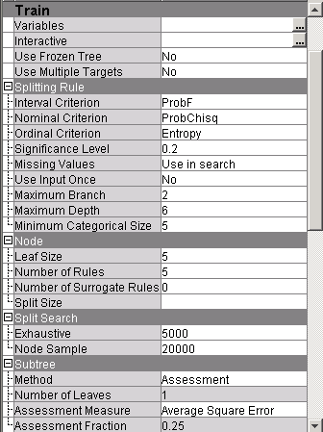
Tree Variations: Maximum Branches
Maximum branches in split
Exhaustive search size limit
...

Slide 48
Tree Variations: Splitting Rule Criterion
Yields similar splits
Grows enormous trees
Favors many-level inputs
...

Slide 49
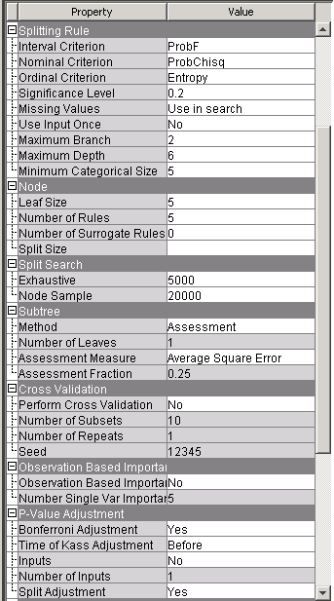
Tree Variations: Splitting Rule Criterion
Split Criterion
Chi-square logworth
Entropy
Gini
Categorical Criteria
Variance
Prob-F logworth
Interval Criteria
Logworth adjustments
...

Slide 50
Tree Variations: Subtree Method
Controls Complexity
...

Slide 51
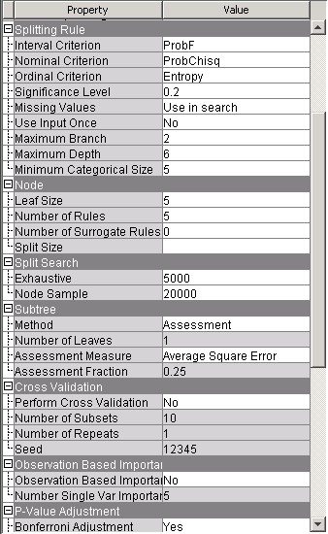
Tree Variations: Subtree Method
Assessment
Largest
N
Pruning options
Pruning metrics
Decision
Average Square Error
Misclassification
Lift
...

Slide 52
Tree Variations: Tree Size Options
Avoids orphan nodes
Controls sensitivity
Grows large trees
...

Slide 53
Tree Variations: Tree Size Options
Logworth threshold
Maximum tree depth
Minimum leaf size
Threshold depth adjustment

